Slide 1
ME 161 Basic Mechanics
KN US&T Kumasi-Ghana
Instructor: Dr. Joshua Ampofo

Slide 2
Rigid Bodies: Equivalent Systems of Forces

Slide 3
Introduction
Treatment of a body as a single particle is not always possible. In general, the size of the body and the specific points of application of the forces must be considered.
Most bodies in elementary mechanics are assumed to be rigid, i.e., the actual deformations are small and do not affect the conditions of equilibrium or motion of the body.
Any system of forces acting on a rigid body can be replaced by an equivalent system consisting of one force acting at a given point and one couple.

Slide 4
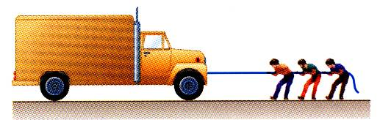
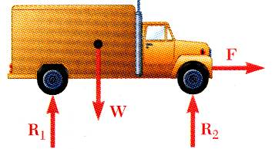
External and Internal Forces
Forces acting on rigid bodies are divided into two groups:
  External forces
  Internal forces
External forces are shown in a free-body diagram.
If unopposed, each external force can impart a motion of translation or rotation, or both.

Slide 5
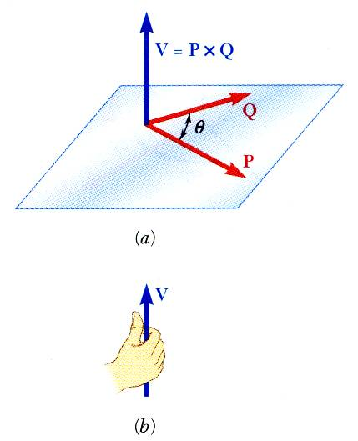



Vector Product of Two Vectors
Concept of the moment of a force about a point is more easily understood through applications of the vector product or cross product.
Vector product of two vectors P and Q is defined as the vector V which satisfies the following conditions:
  Line of action of V is perpendicular to plane containing P and Q.
  Magnitude of V is
  Direction of V is obtained from the right-hand rule.
Vector products:
  are not commutative,
  are distributive,
  are not associative,

Slide 6
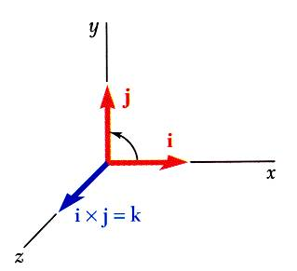
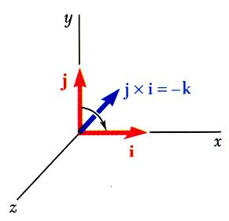
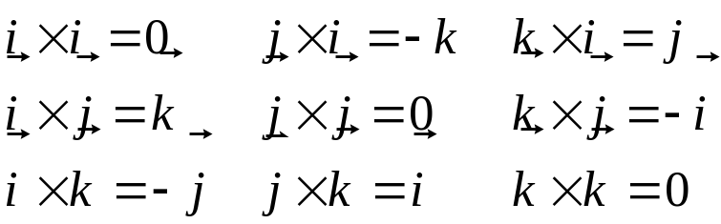
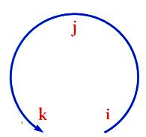
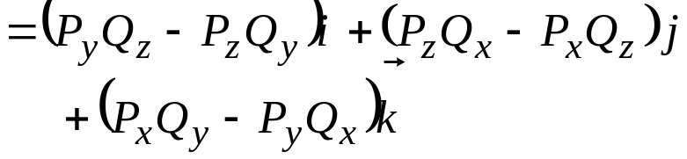
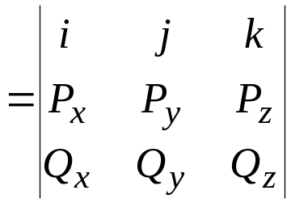
Vector Products
Vector products of Cartesian unit vectors,
Vector products in terms of rectangular coordinates

Slide 7
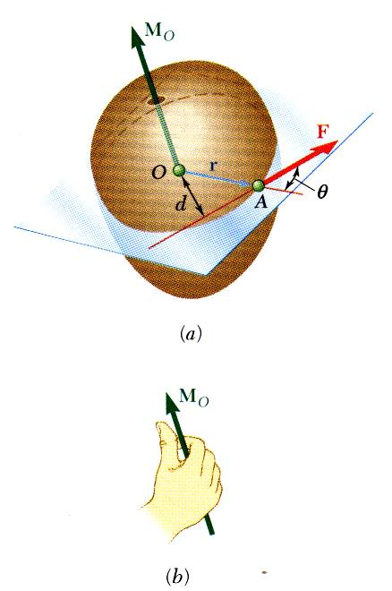


Moment of a Force About a Point
The moment of F about O is defined as
The moment vector M_{O} is perpendicular to the plane containing O and the force F.
Magnitude of M_{O} measures the tendency of the force to cause rotation of the body about an axis along M_{O}.
The sense of the moment may be determined by the right-hand rule.
Any force F’ that has the same magnitude and direction as F, is equivalent if it also has the same line of action and therefore, produces the same moment.

Slide 8
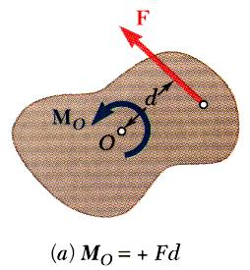
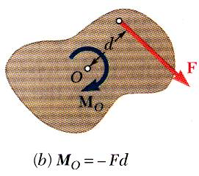
Moment of a Force About a Point
Two-dimensional structures have length and breadth but negligible depth and are subjected to forces contained in the plane of the structure.
The plane of the structure contains the point O and the force F. M_{O}, the moment of the force about O is perpendicular to the plane.
If the force tends to rotate the structure clockwise, the sense of the moment vector is out of the plane of the structure and the magnitude of the moment is positive.
If the force tends to rotate the structure counterclockwise, the sense of the moment vector is into the plane of the structure and the magnitude of the moment is negative.

Slide 9
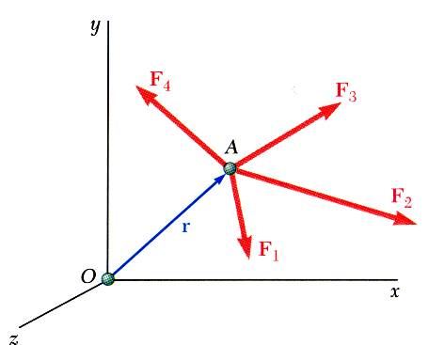
Varignon’s Theorem
The moment about a give point O of the resultant of several concurrent forces is equal to the sum of the moments of the various moments about the same point O.
Varigon’s Theorem makes it possible to replace the direct determination of the moment of a force F by the moments of two or more component forces of F.

Slide 10
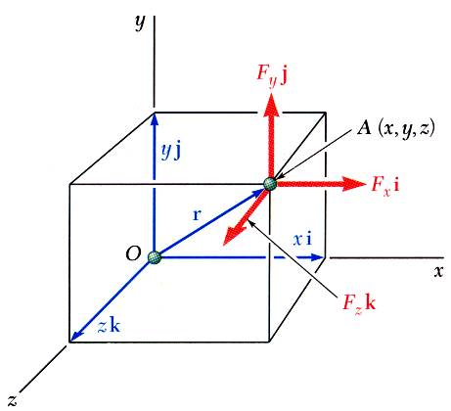
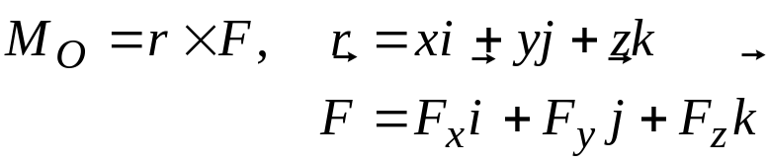
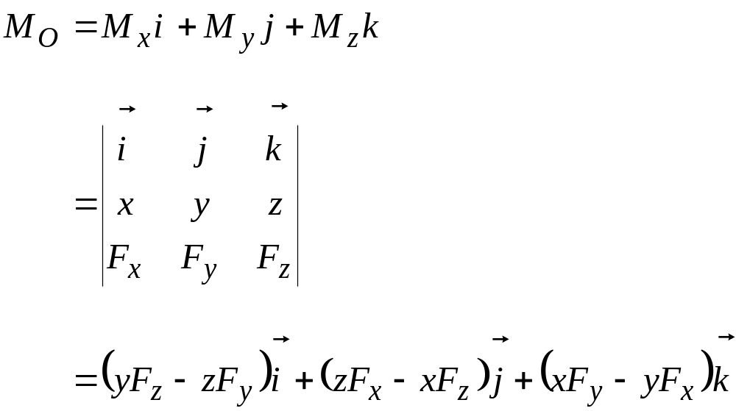
Rectangular Components of the Moment of a Force
The moment of F about O,

Slide 11
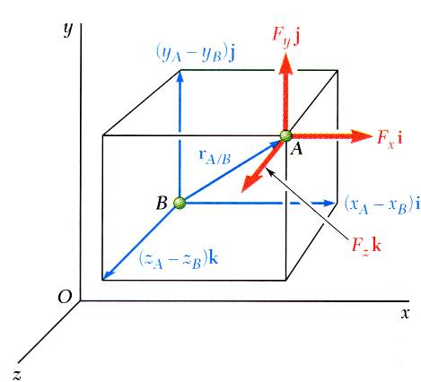

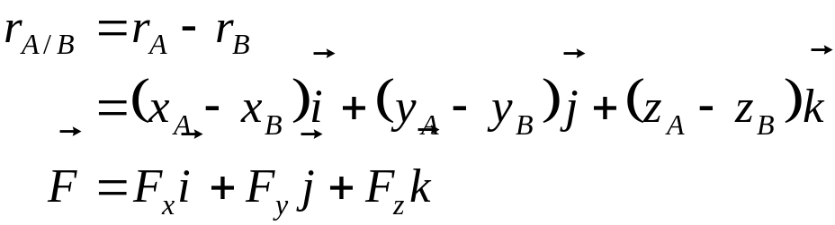
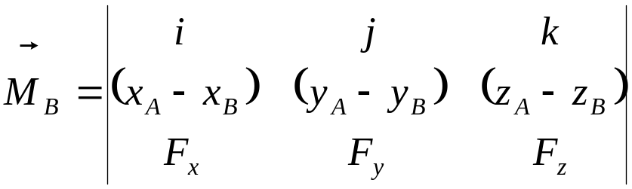
Rectangular Components of the Moment of a Force
The moment of F about B,

Slide 12
Sample Problem 3.1
A
A 50-N vertical force is applied to the end of a lever which is attached to a shaft at O.
Determine:
moment about O,
horizontal force at A which creates the same moment,
smallest force at A which produces the same moment,
location for a 125-N vertical force to produce the same moment,
20 cm
50 N
60º
O

Slide 13
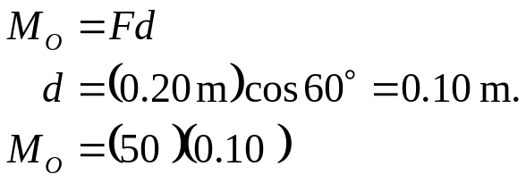

Sample Problem 3.1
A
Moment about O is equal to the product of the force and the perpendicular distance between the line of action of the force and O. Since the force tends to rotate the lever clockwise, the moment vector is into the plane of the paper.
(a)
20 cm
50 N
60º
O
d
M_{o}

Slide 14
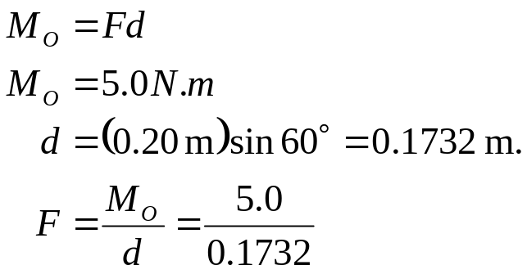

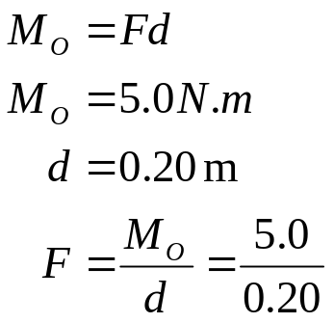

Sample Problem 3.1
A
(b) horizontal force at A which creates the same moment
F
20 cm
d
60º
A
O
M_{o}=5.0 N.m
F
(c) smallest force at A which produces the same moment,
20 cm
60º
O
M_{o}=5.0 N.m

Slide 15
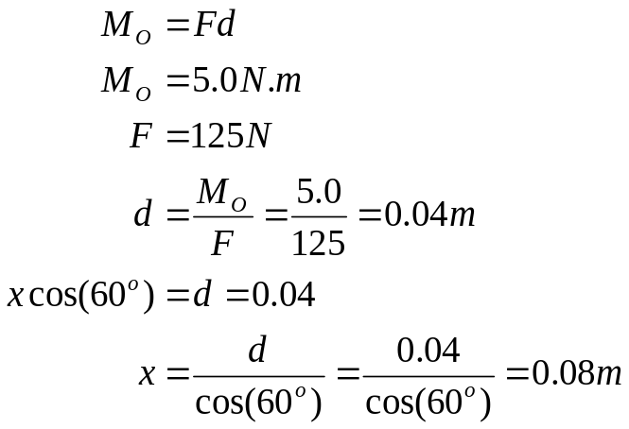

Sample Problem 3.1
(d) location for a 125-N vertical force to produce the same moment,
A
x
125 N
60º
O
d
M_{o}=5.0 N.m

Slide 16
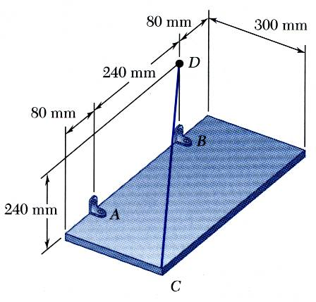

Sample Problem 3.4
SOLUTION:
The moment M_{A} of the force F exerted by the wire is obtained by evaluating the vector product,
The rectangular plate is supported by the brackets at A and B and by a wire CD. Knowing that the tension in the wire is 200 N, determine the moment about A of the force exerted by the wire at C.

Slide 17
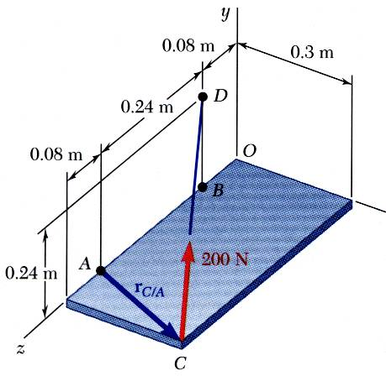
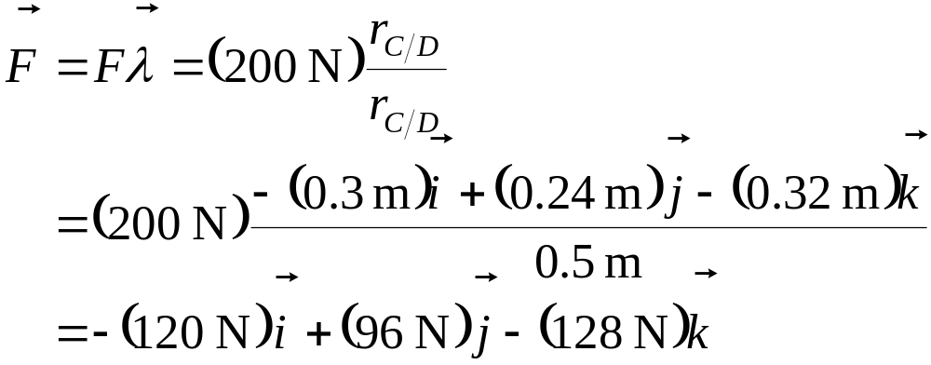
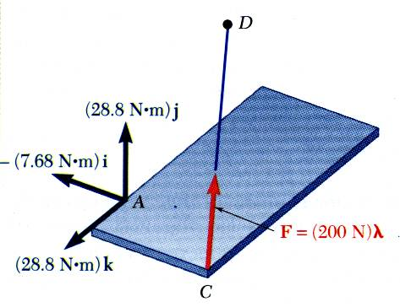
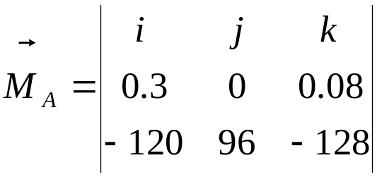
Sample Problem 3.4
SOLUTION:

Slide 18
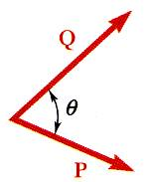




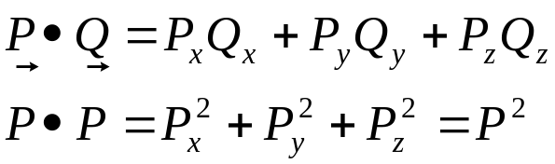
Scalar Product of Two Vectors
The scalar product or dot product between two vectors P and Q is defined as
Scalar products:
  are commutative,
  are distributive,
  are not associative,
Scalar products with Cartesian unit components,

Slide 19
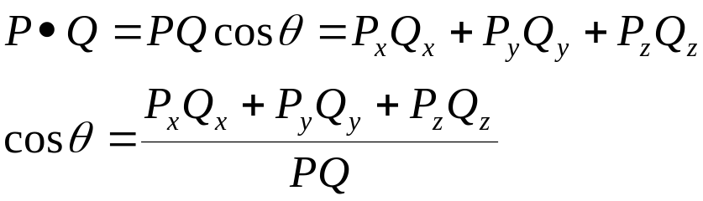
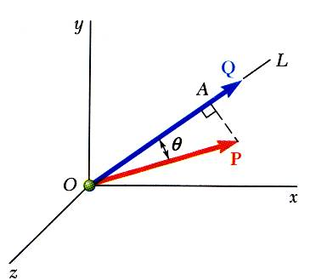
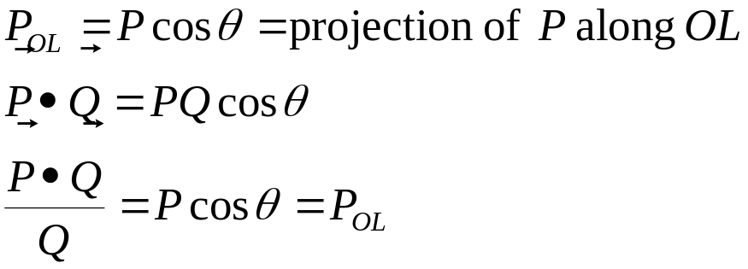
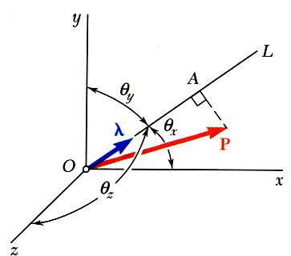
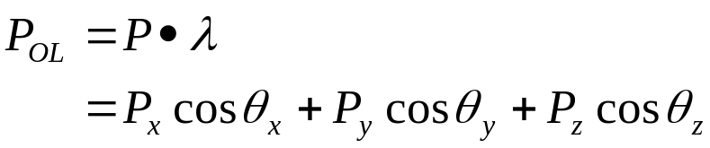
Scalar Product of Two Vectors
Angle between two vectors:
Projection of a vector on a given axis:
For an axis defined by a unit vector:

Slide 20
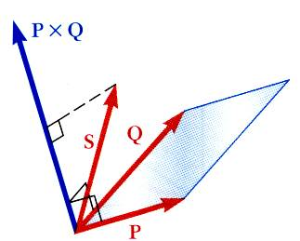

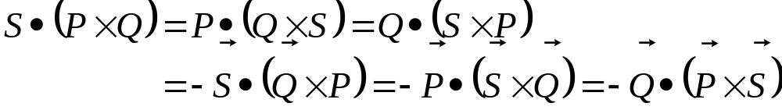
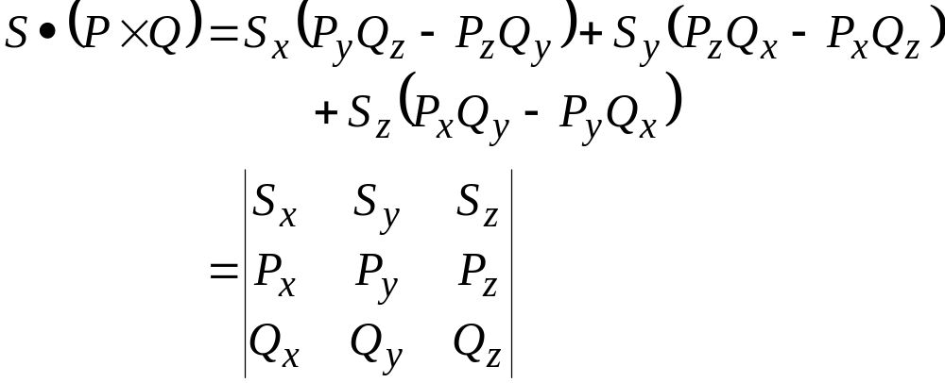
Mixed Triple Product of Three Vectors
Mixed triple product of three vectors,
The six mixed triple products formed from S, P, and Q have equal magnitudes but not the same sign,
Evaluating the mixed triple product,

Slide 21
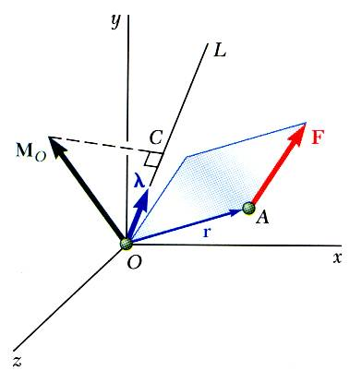


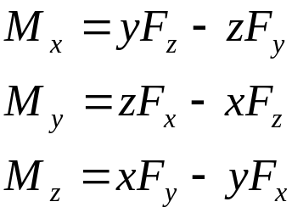
Moment of a Force About a Given Axis
Moment M_{O} of a force F applied at the point A about a point O,
Scalar moment M_{OL} about an axis OL is the projection of the moment vector M_{O} onto the axis,
Moments of F about the coordinate axes,

Slide 22
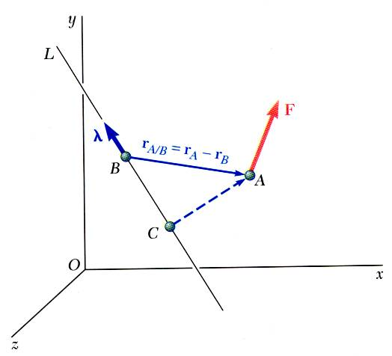
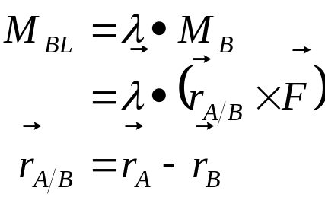
Moment of a Force About a Given Axis
Moment of a force about an arbitrary axis,
The result is independent of the point B along the given axis.

Slide 23
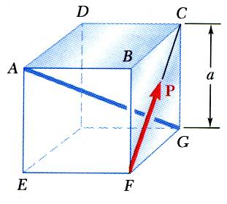
Sample Problem 3.5
A cube is acted on by a force P as shown. Determine the moment of P
about A
about the edge AB and
about the diagonal AG of the cube.
Determine the perpendicular distance between AG and FC.

Slide 24
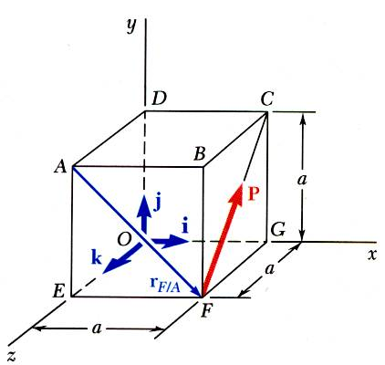
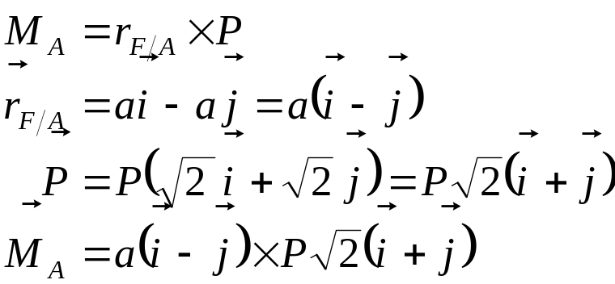

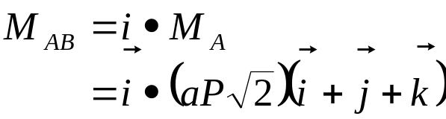

Sample Problem 3.5
Moment of P about A,
Moment of P about AB,

Slide 25
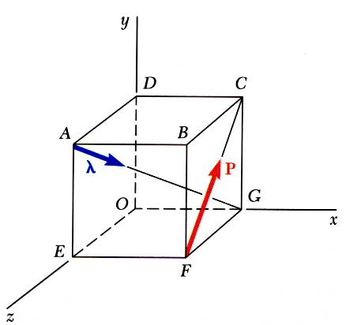
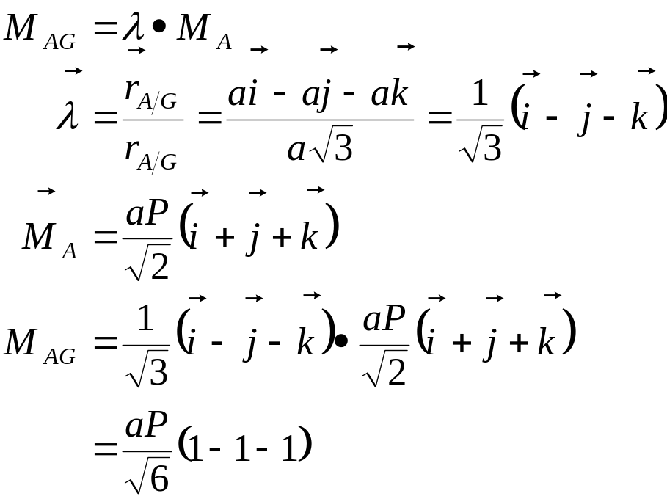
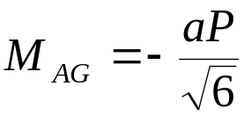
Sample Problem 3.5
Moment of P about the diagonal AG,

Slide 26
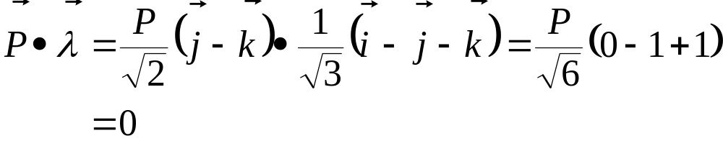



Sample Problem 3.5
Perpendicular distance between AG and FC,
Therefore, P is perpendicular to AG.

Slide 27




Moment of a Couple
Two forces F and -F having the same magnitude, parallel lines of action, and opposite sense are said to form a couple.
Moment of the couple,
The moment vector of the couple is independent of the choice of the origin of the coordinate axes, i.e., it is a free vector that can be applied at any point with the same effect.

Slide 28


Moment of a Couple
Two couples will have equal moments if
the two couples lie in parallel planes, and
the two couples have the same sense or the tendency to cause rotation in the same direction.

Slide 29





Addition of Couples
Consider two intersecting planes P₁ and P₂ with each containing a couple
Resultants of the vectors also form a couple
By Varigon’s theorem
Sum of two couples is also a couple that is equal to the vector sum of the two couples

Slide 30

Couples Can Be Represented by Vectors
A couple can be represented by a vector with magnitude and direction equal to the moment of the couple.
Couple vectors obey the law of addition of vectors.
Couple vectors are free vectors, i.e., the point of application is not significant.
Couple vectors may be resolved into component vectors.

